Slide 1


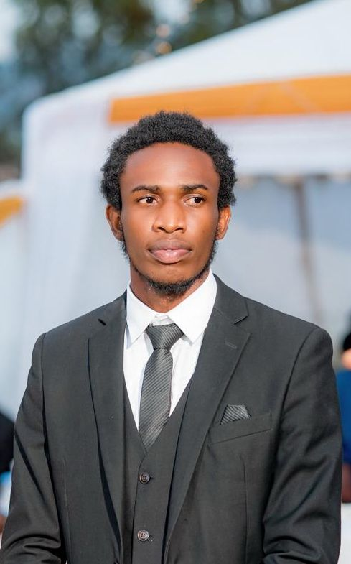



Personal introduction: Christian Hirwa
Personal introduction
Background
Location
3rd year software engineering student at AUCA focusing on becoming a software developer.
Christian Hirwa is an IT student department of software engineering.
LinkedIn profile
Live in
KIGALI-RWANDA
Course expectations
Digital information usage
Hobbies
I'm passionate about photography and enjoy capturing the stunning landscapes of Rwanda in my free time.
The course aims to enhance my understanding of PL/SQL and provide practical experience in creating efficient and secure databases for real-world applications.
The author utilizes digital tools like Oracle SQL Developer, MySQL Workbench, GitHub for version control, and Google Workspace for project management and collaboration.

